Slide 1

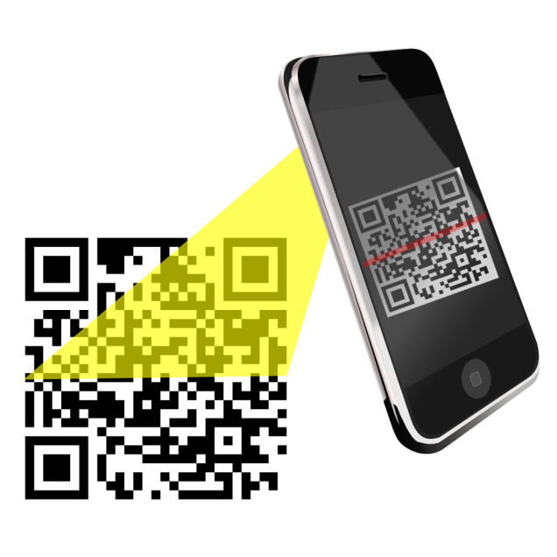
QR Code Management System

Slide 2


INTRODUCTION
SMS Text Messaging Alert System.
Installed in Smartphone or a server with a GSM device connected.
QR code is a quick response code .
Saves time and efforts of instructor.
Used for sharing notes.

Slide 3


OBJECTIVE
Database of student and performance monitoring.
To send SMS alerts to the parent/guardian.
Allow access of student details via mobile.
Providing platform to the students and teachers.
Alert Regarding shortage of attendance

Slide 4


SMS FEATURES
Managing Contacts.
Managing Groups.
Sending message to desired contacts and numbers.
Internet is NOT required(SMS).
User Friendly Software.

Slide 5


EXISTING SYSTEM
A Separate person has to be kept.
Event and Placement notifications may not be received.
Information placed on the notice board may not be accessed by all students.

Slide 6


PROPOSED SYSTEM
Notification regarding events and other activities using SMS system.
Manual process are avoided.
Marks and attendance can be retrieved.
Client to server communication for students.
Details of lecturer are given like contact number

Slide 7


APPLICATIONS
Individual profile for each student are maintained.
SMS alerts contain students performance and faculty contact numbers are given to parents.
Code along with student identity confirms the attendance.
Information regarding memo are given.
Notes sharing

Slide 8

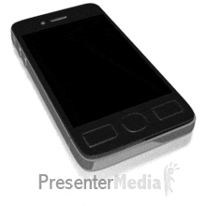
SYSTEM REQUIREMETS Hardware
Processor having a clock speed of at least 1 GHz and minimum of 256MB RAM.
Secondary memory of a minimum of 100GB.
GSM modem/server to send SMS alerts.
Mobile phone or a GSM modem is required to receive SMS.

Slide 9

SYSTEM REQUIREMETS Software
Languages : Java, JavaScript, XML,CSS
Compilers: Java C compiler,
Software: Eclipse, Android SDK
Database: SQlite
Editors used: Text editors.

Slide 10

ADVANTAGES
Students and Parents can access anytime for various queries.
Parents are sent regular SMS alerts.
It has a user friendly user interface for the convenience of parents and also students .
The faculty in-charge can monitor the student and their performances.

Slide 11


DISADVANTAGES
Only the performance with respect to the academic curriculum is maintained.
The SMS alert service cannot be assured delivery of the messages in case of a network jam.
Is not device independent.
Daily database should be updated

Slide 12

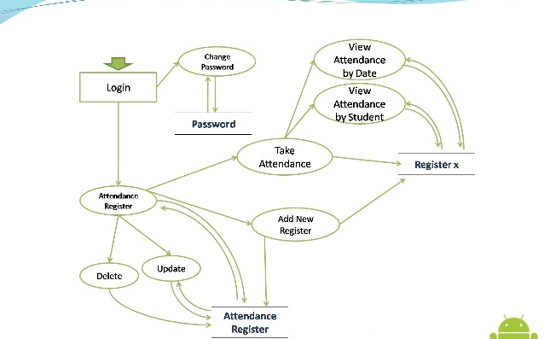
USE CASE DIAGRAM

Slide 13
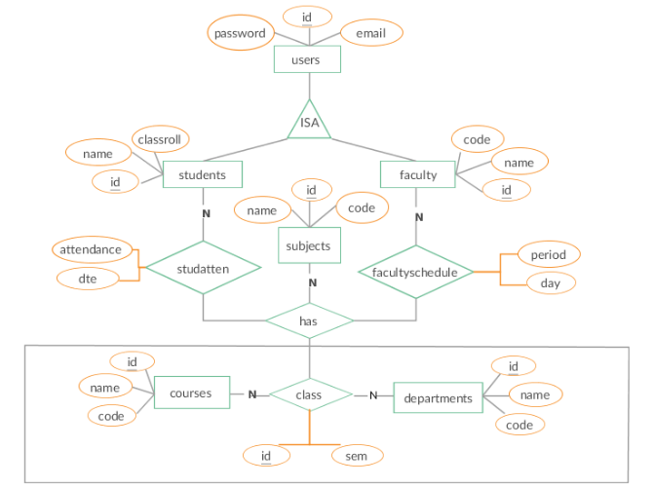
ER DIAGRAM

Slide 14

MODULES
Student Register – can get registered using unique ID.
Marks and Attendance Update – information updated in database.
Sending SMS - SMS’s are sent to the students depending on the category.
Notice - In this module messages can be sent to the faculty.
Broadcast message- SMS will be sent regarding placement and memo

Slide 15

FUNCTIONAL REQUIREMENT
User must enter a valid login ID and password.
Invalid ID leads to password recover, valid ID is taken to user respective page.
Details searched by the admin are retrieved .
Admin logout’s once his/her work is finished.
Admin regularly updates the details .

Slide 16

NON-FUNCTIONAL REQUIREMENT
Secure access of confidential data.
24x7 availability .
Better component design to get a better peak time performance.

Slide 17

QR CODE
Quick Response Code is a trademark for a type of
matrix barcode.
Fast readability and greater storage capacity.
Code consist of black modules arranged in square grid on white background.
QR code may be scanned by any imaging devices
Information encoded is made up of four types of data.
Data is extracted from patterns

Slide 18
TESTING Unit Testing
Involves the design of test cases.
Unit tests perform basic tests at component level.
FUNCTIONAL TEST
Valid Input : identified classes of valid input must be accepted
Invalid Input : identified classes of invalid input must be rejected.

Slide 19
SYSTEM TEST
Ensures that software system meets requirements
Tests a configuration to ensure known and predictable results
Based on process descriptions and flows
PERFORMANCE TEST
Ensures that the output produced within the time limits and the time taken by the system for compiling
Calculated the time period of giving response.

Slide 20

INTEGRATION TEST
Is the incremental integration testing of two or more integrated software components on a single platform.
Main task is to check components interact without errors.

Slide 21

FUTURE ENHANCEMENT
This system also notifies the pupil’s parents via SMS alerts of their performance and attendance.
It can enhanced through GPS tracking.
Database can be created for lectures .
An application for Transfer Certificate is built.

Slide 22

CONCLUSION
Time taken by instructors to take attendance ,so we use QR code attendance system.
Proxy Attendance is secured.
Easy way to get notes sharing via SMS.
Timetable and memo sharing in easy way.

Slide 23

Making Video

Slide 24



SUBMITTED BY
SAGAR
ARCHANA
ANUSUYA
AKSHAY ACHARYA

